Slide 1

Logistic Regression
汤斯亮（Siliang Tang）
siliang@zju.edu.cn

Slide 2
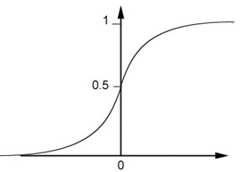

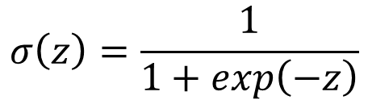




Step 1: Function Set
Function set:
Including all different w and b
$$P_{w,b}\left(C_{1}|x\right)≥0.5$$
class 1
z
0
$$P_{w,b}\left(C_{1}|x\right)<0.5$$
class 2
z
0
$$P_{w,b}\left(C_{1}|x\right)=σ\left(z\right)$$
$$=\sum_{i}{w_{i}x_{i}}+b$$
$$z=w∙x+b$$
$$σ\left(z\right)=\frac{1}{1+exp\left(−z\right)}$$

Slide 3

Step 1: Function Set
…
…
$$P_{w,b}\left(C_{1}|x\right)$$
…
…
Sigmoid Function
Notes:
Activation function

Slide 4










Step 2: Goodness of a Function
Training
Data
$$x^{1}$$
$$x^{2}$$
$$x^{3}$$
$$x^{N}$$
$$……$$
$$C_{1}$$
$$C_{1}$$
$$C_{2}$$
$$C_{1}$$
Assume the data is generated based on $f_{w,b}\left(x\right)=P_{w,b}\left(C_{1}|x\right)$
Given a set of w and b, what is its probability of generating the data?
$$L\left(w,b\right)=f_{w,b}\left(x^{1}\right)f_{w,b}\left(x^{2}\right)\left(1−f_{w,b}\left(x^{3}\right)\right)⋯f_{w,b}\left(x^{N}\right)$$
The most likely w* and b* is the one with the largest $L\left(w,b\right)$.
$$w^{∗},b^{∗}=arg\max_{w,b}{L\left(w,b\right)}$$
Notes:
All the w and b give non-zero probability

Slide 5
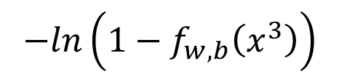







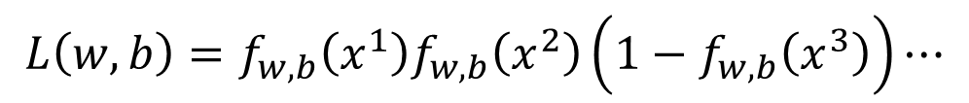








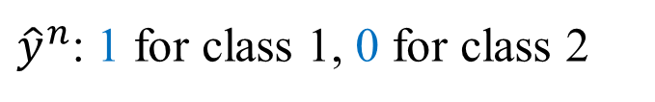


$$x^{1}$$
$$x^{2}$$
$$x^{3}$$
$$x^{1}$$
$$x^{2}$$
$$x^{3}$$
$$……$$
$$……$$
$$C_{1}$$
$$C_{1}$$
$$C_{2}$$
$${\hat{y}}^{1}=1$$
$${\hat{y}}^{2}=1$$
$${\hat{y}}^{3}=0$$
${\hat{y}}^{n}$: 1 for class 1, 0 for class 2
$$L\left(w,b\right)=f_{w,b}\left(x^{1}\right)f_{w,b}\left(x^{2}\right)\left(1−f_{w,b}\left(x^{3}\right)\right)⋯$$
$$w^{∗},b^{∗}=arg\max_{w,b}{L\left(w,b\right)}$$
=
$$w^{∗},b^{∗}=arg\min_{w,b}{−lnL\left(w,b\right)}$$
$$−lnL\left(w,b\right)$$
$$=−lnf_{w,b}\left(x^{1}\right)$$
1
$$−\left[{\hat{y}}^{1}lnf\left(x^{1}\right)+\left(1−{\hat{y}}^{1}\right)ln\left(1−f\left(x^{1}\right)\right)\right]$$
0
$$−lnf_{w,b}\left(x^{2}\right)$$
1
$$−\left[{\hat{y}}^{2}lnf\left(x^{2}\right)+\left(1−{\hat{y}}^{2}\right)ln\left(1−f\left(x^{2}\right)\right)\right]$$
0
$$−ln\left(1−f_{w,b}\left(x^{3}\right)\right)$$
$$−\left[{\hat{y}}^{3}lnf\left(x^{3}\right)+\left(1−{\hat{y}}^{3}\right)ln\left(1−f\left(x^{3}\right)\right)\right]$$
0
1
……

Slide 6



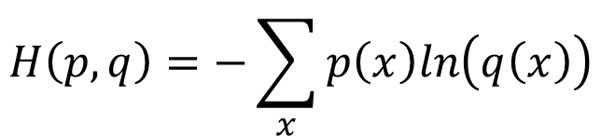
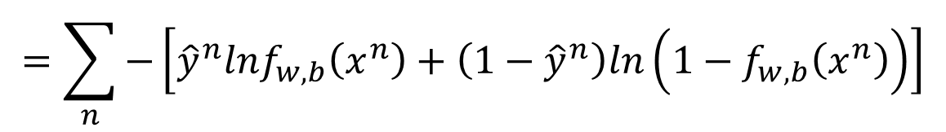


Step 2: Goodness of a Function
$$L\left(w,b\right)=f_{w,b}\left(x^{1}\right)f_{w,b}\left(x^{2}\right)\left(1−f_{w,b}\left(x^{3}\right)\right)⋯f_{w,b}\left(x^{N}\right)$$
$$−lnL\left(w,b\right)=lnf_{w,b}\left(x^{1}\right)+lnf_{w,b}\left(x^{2}\right)+ln\left(1−f_{w,b}\left(x^{3}\right)\right)⋯$$
${\hat{y}}^{n}$: 1 for class 1, 0 for class 2
$$=\sum_{n}{−\left[{\hat{y}}^{n}lnf_{w,b}\left(x^{n}\right)+\left(1−{\hat{y}}^{n}\right)ln\left(1−f_{w,b}\left(x^{n}\right)\right)\right]}$$
Cross entropy between two Bernoulli distribution
Distribution p:
Distribution q:
$$p\left(x=1\right)={\hat{y}}^{n}$$
cross entropy
$$q\left(x=1\right)=f\left(x^{n}\right)$$
$$p\left(x=0\right)={1−\hat{y}}^{n}$$
$$q\left(x=0\right)=1−f\left(x^{n}\right)$$
$$H\left(p,q\right)=−\sum_{x}{p\left(x\right)ln\left(q\left(x\right)\right)}$$
Notes:
Where does it comes from?

Slide 7


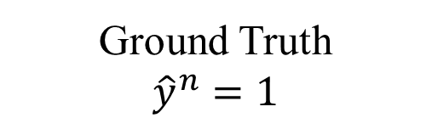
Step 2: Goodness of a Function
$$L\left(w,b\right)=f_{w,b}\left(x^{1}\right)f_{w,b}\left(x^{2}\right)\left(1−f_{w,b}\left(x^{3}\right)\right)⋯f_{w,b}\left(x^{N}\right)$$
$$−lnL\left(w,b\right)=lnf_{w,b}\left(x^{1}\right)+lnf_{w,b}\left(x^{2}\right)+ln\left(1−f_{w,b}\left(x^{3}\right)\right)⋯$$
${\hat{y}}^{n}$: 1 for class 1, 0 for class 2
$$=\sum_{n}{−\left[{\hat{y}}^{n}lnf_{w,b}\left(x^{n}\right)+\left(1−{\hat{y}}^{n}\right)ln\left(1−f_{w,b}\left(x^{n}\right)\right)\right]}$$
Cross entropy between two Bernoulli distribution
minimize
1.0
$$f\left(x^{n}\right)$$
0.0
cross entropy
$$1−f\left(x^{n}\right)$$
Ground Truth
$${\hat{y}}^{n}=1$$
Notes:
Where does it comes from?

Slide 8
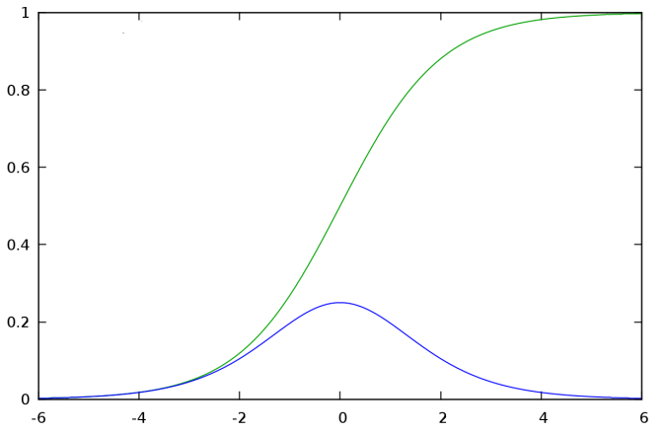

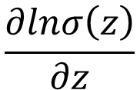


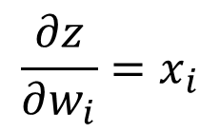




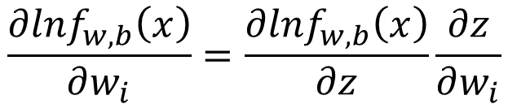

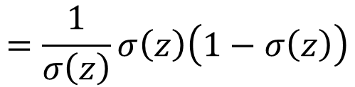
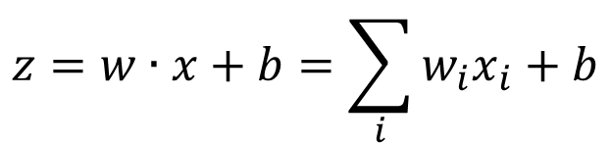

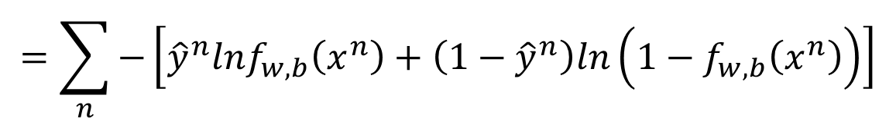
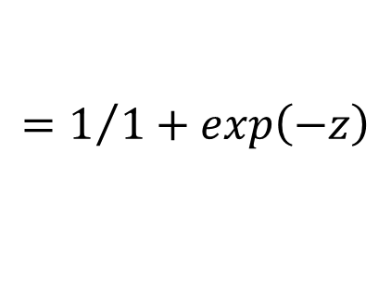
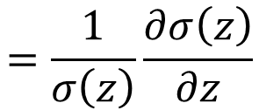
Step 3: Find the best function
$$\left(1−f_{w,b}\left(x^{n}\right)\right)x_{i}^{n}$$
$$=\sum_{n}{−\left[{\hat{y}}^{n}lnf_{w,b}\left(x^{n}\right)+\left(1−{\hat{y}}^{n}\right)ln\left(1−f_{w,b}\left(x^{n}\right)\right)\right]}$$
$$−lnL\left(w,b\right)$$
$$∂w_{i}$$
$$∂w_{i}$$
$$∂w_{i}$$
$$\frac{∂lnf_{w,b}\left(x\right)}{∂w_{i}}=\frac{∂lnf_{w,b}\left(x\right)}{∂z}\frac{∂z}{∂w_{i}}$$
$$\frac{∂z}{∂w_{i}}=x_{i}$$
$$σ\left(z\right)$$
$$\frac{∂σ\left(z\right)}{∂z}$$
$$\frac{∂lnσ\left(z\right)}{∂z}$$
$$=\frac{1}{σ\left(z\right)}\frac{∂σ\left(z\right)}{∂z}$$
$$=\frac{1}{σ\left(z\right)}σ\left(z\right)\left(1−σ\left(z\right)\right)$$
$$f_{w,b}\left(x\right)$$
$$=σ\left(z\right)$$
$$z=w∙x+b=\sum_{i}{w_{i}x_{i}}+b$$
$$=1/{1+exp\left(−z\right)}$$

Slide 9

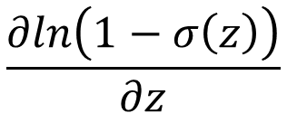

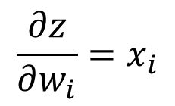

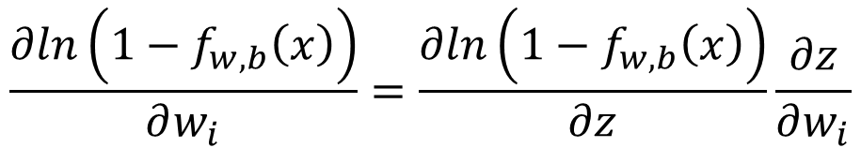
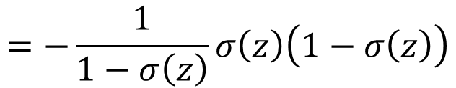
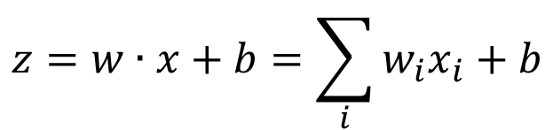
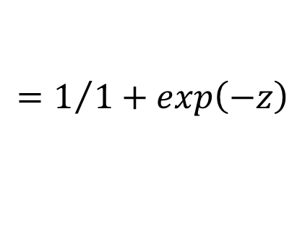
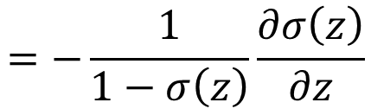
Step 3: Find the best function
$$\left(1−f_{w,b}\left(x^{n}\right)\right)x_{i}^{n}$$
$$−f_{w,b}\left(x^{n}\right)x_{i}^{n}$$
$$=\sum_{n}{−\left[{\hat{y}}^{n}lnf_{w,b}\left(x^{n}\right)+\left(1−{\hat{y}}^{n}\right)ln\left(1−f_{w,b}\left(x^{n}\right)\right)\right]}$$
$$−lnL\left(w,b\right)$$
$$∂w_{i}$$
$$∂w_{i}$$
$$∂w_{i}$$
$$\frac{∂ln\left(1−f_{w,b}\left(x\right)\right)}{∂w_{i}}=\frac{∂ln\left(1−f_{w,b}\left(x\right)\right)}{∂z}\frac{∂z}{∂w_{i}}$$
$$\frac{∂z}{∂w_{i}}=x_{i}$$
$$\frac{∂ln\left(1−σ\left(z\right)\right)}{∂z}$$
$$=−\frac{1}{1−σ\left(z\right)}\frac{∂σ\left(z\right)}{∂z}$$
$$=−\frac{1}{1−σ\left(z\right)}σ\left(z\right)\left(1−σ\left(z\right)\right)$$
$$f_{w,b}\left(x\right)$$
$$=σ\left(z\right)$$
$$z=w∙x+b=\sum_{i}{w_{i}x_{i}}+b$$
$$=1/{1+exp\left(−z\right)}$$

Slide 10
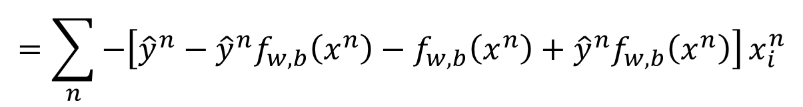

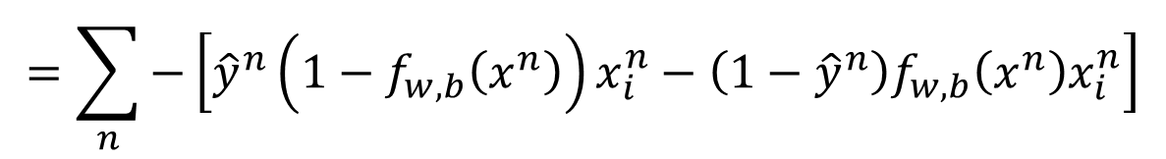





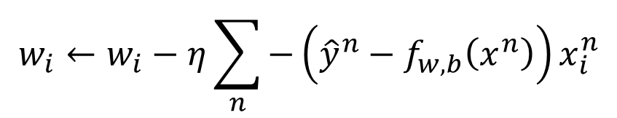
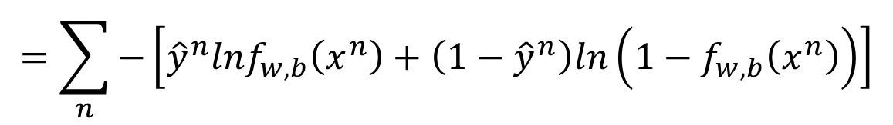
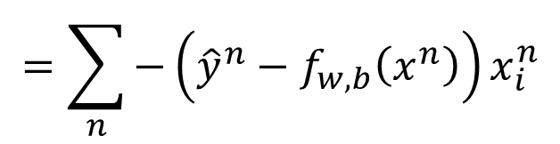
Step 3: Find the best function
$$\left(1−f_{w,b}\left(x^{n}\right)\right)x_{i}^{n}$$
$$−f_{w,b}\left(x^{n}\right)x_{i}^{n}$$
$$=\sum_{n}{−\left[{\hat{y}}^{n}lnf_{w,b}\left(x^{n}\right)+\left(1−{\hat{y}}^{n}\right)ln\left(1−f_{w,b}\left(x^{n}\right)\right)\right]}$$
$$−lnL\left(w,b\right)$$
$$∂w_{i}$$
$$∂w_{i}$$
$$∂w_{i}$$
$$=\sum_{n}{−\left[{\hat{y}}^{n}\left(1−f_{w,b}\left(x^{n}\right)\right)x_{i}^{n}−\left(1−{\hat{y}}^{n}\right)f_{w,b}\left(x^{n}\right)x_{i}^{n}\right]}$$
$$=\sum_{n}{−\left[{\hat{y}}^{n}−{\hat{y}}^{n}f_{w,b}\left(x^{n}\right)−f_{w,b}\left(x^{n}\right)+{\hat{y}}^{n}f_{w,b}\left(x^{n}\right)\right]}x_{i}^{n}$$
$$=\sum_{n}{−\left({\hat{y}}^{n}−f_{w,b}\left(x^{n}\right)\right)x_{i}^{n}}$$
Larger difference, larger update
$$w_{i}←w_{i}−η\sum_{n}{−\left({\hat{y}}^{n}−f_{w,b}\left(x^{n}\right)\right)x_{i}^{n}}$$

Slide 11

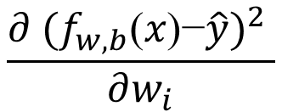

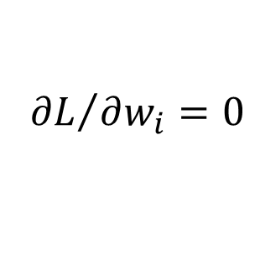
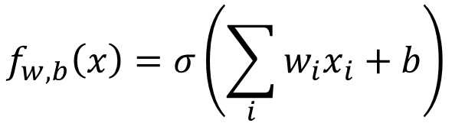
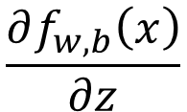
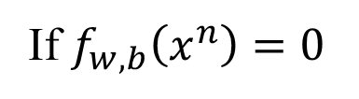

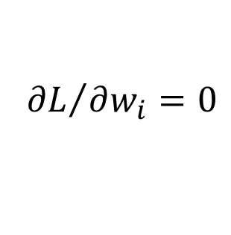
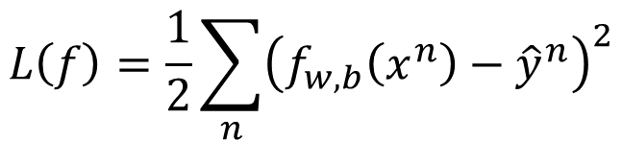
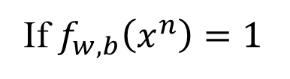

Logistic Regression + Square Error
$$f_{w,b}\left(x\right)=σ\left(\sum_{i}{w_{i}x_{i}}+b\right)$$
Step 1:
Step 2:
Training data: $\left(x^{n},{\hat{y}}^{n}\right)$, ${\hat{y}}^{n}$: 1 for class 1, 0 for class 2
$$L\left(f\right)=\frac{1}{2}\sum_{n}{{\left(f_{w,b}\left(x^{n}\right)−{\hat{y}}^{n}\right)}^{2}}$$
Step 3:
$$\frac{∂f_{w,b}\left(x\right)}{∂z}$$
$$\frac{∂z}{∂w_{i}}$$
$$=2\left(f_{w,b}\left(x\right)−\hat{y}\right)$$
$$\frac{∂ {(f_{w,b}\text{(}\text{x}\text{)−}\hat{y})}^{2} }{∂w_{i}}$$
$$=2\left(f_{w,b}\left(x\right)−\hat{y}\right)f_{w,b}\left(x\right)\left(1−f_{w,b}\left(x\right)\right)x_{i}$$
$${\hat{y}}^{n}=1$$
If $f_{w,b}\left(x^{n}\right)=1$
(close to target)
$${∂L}/{∂w_{i}}=0$$
If $f_{w,b}\left(x^{n}\right)=0$
(far from target)
$${∂L}/{∂w_{i}}=0$$

Slide 12

Logistic Regression + Square Error
$$f_{w,b}\left(x\right)=σ\left(\sum_{i}{w_{i}x_{i}}+b\right)$$
Step 1:
Step 2:
Training data: $\left(x^{n},{\hat{y}}^{n}\right)$, ${\hat{y}}^{n}$: 1 for class 1, 0 for class 2
$$L\left(f\right)=\frac{1}{2}\sum_{n}{{\left(f_{w,b}\left(x^{n}\right)−{\hat{y}}^{n}\right)}^{2}}$$
Step 3:
$$\frac{∂f_{w,b}\left(x\right)}{∂z}$$
$$\frac{∂z}{∂w_{i}}$$
$$=2\left(f_{w,b}\left(x\right)−\hat{y}\right)$$
$$\frac{∂ {(f_{w,b}\text{(}\text{x}\text{)−}\hat{y})}^{2} }{∂w_{i}}$$
$$=2\left(f_{w,b}\left(x\right)−\hat{y}\right)f_{w,b}\left(x\right)\left(1−f_{w,b}\left(x\right)\right)x_{i}$$
$${\hat{y}}^{n}=0$$
If $f_{w,b}\left(x^{n}\right)=1$
(far from target)
$${∂L}/{∂w_{i}}=0$$
If $f_{w,b}\left(x^{n}\right)=0$
(close to target)
$${∂L}/{∂w_{i}}=0$$

Slide 13
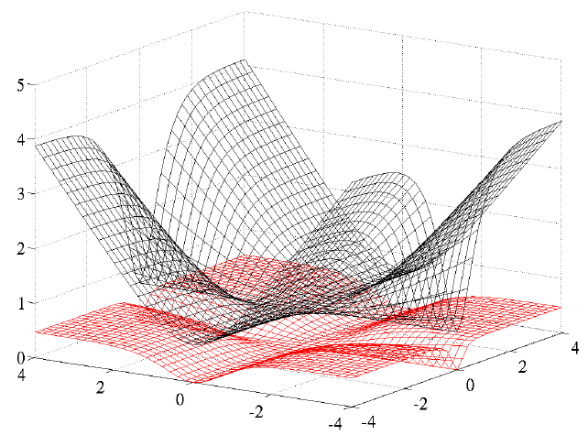
Cross Entropy v.s. Square Error
Cross Entropy
Total
Loss
Square
Error
w₁
w₂
http://jmlr.org/proceedings/papers/v9/glorot10a/glorot10a.pdf

Slide 14
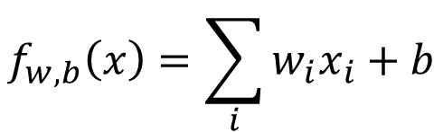
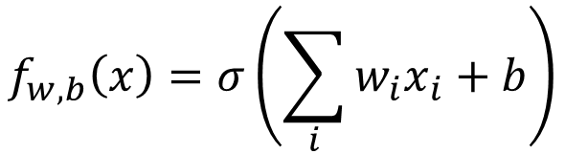
Logistic Regression
Linear Regression
$$f_{w,b}\left(x\right)=σ\left(\sum_{i}{w_{i}x_{i}}+b\right)$$
$$f_{w,b}\left(x\right)=\sum_{i}{w_{i}x_{i}}+b$$
Step 1:
Output: between 0 and 1
Output: any value
Step 2:
Step 3:
Notes:
The standard logistic function is the logistic function with parameters (k = 1, x₀ = 0, L = 1) which yields sigmoid

Slide 15
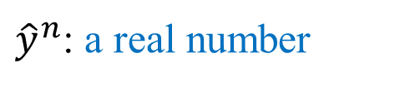
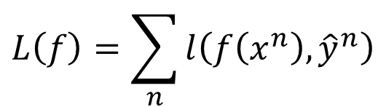
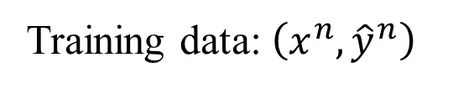
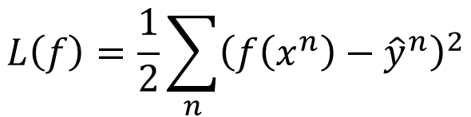
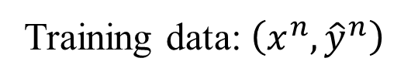

Logistic Regression
Linear Regression
$$f_{w,b}\left(x\right)=σ\left(\sum_{i}{w_{i}x_{i}}+b\right)$$
$$f_{w,b}\left(x\right)=\sum_{i}{w_{i}x_{i}}+b$$
Step 1:
Output: between 0 and 1
Output: any value
Training data: $\left(x^{n},{\hat{y}}^{n}\right)$
Training data: $\left(x^{n},{\hat{y}}^{n}\right)$
Step 2:
${\hat{y}}^{n}$: 1 for class 1, 0 for class 2
${\hat{y}}^{n}$: a real number
$$L\left(f\right)=\sum_{n}{l\left(f\left(x^{n}\right),{\hat{y}}^{n}\right)}$$
$$L\left(f\right)=\frac{1}{2}\sum_{n}{{\left(f\left(x^{n}\right)−{\hat{y}}^{n}\right)}^{2}}$$
Cross entropy:
$$l\left(f\left(x^{n}\right),{\hat{y}}^{n}\right)=−\left[{\hat{y}}^{n}lnf\left(x^{n}\right)+\left(1−{\hat{y}}^{n}\right)ln\left(1−f\left(x^{n}\right)\right)\right]$$
Notes:
The standard logistic function is the logistic function with parameters (k = 1, x₀ = 0, L = 1) which yields sigmoid

Slide 16
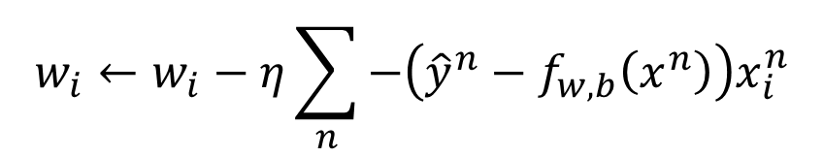
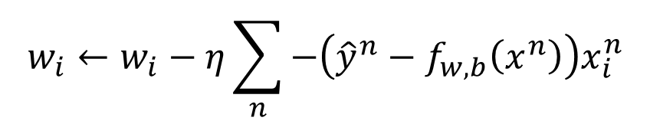
Logistic Regression
Linear Regression
$$f_{w,b}\left(x\right)=σ\left(\sum_{i}{w_{i}x_{i}}+b\right)$$
$$f_{w,b}\left(x\right)=\sum_{i}{w_{i}x_{i}}+b$$
Step 1:
Output: between 0 and 1
Output: any value
Training data: $\left(x^{n},{\hat{y}}^{n}\right)$
Training data: $\left(x^{n},{\hat{y}}^{n}\right)$
Step 2:
${\hat{y}}^{n}$: 1 for class 1, 0 for class 2
${\hat{y}}^{n}$: a real number
$$L\left(f\right)=\sum_{n}{l\left(f\left(x^{n}\right),{\hat{y}}^{n}\right)}$$
$$L\left(f\right)=\frac{1}{2}\sum_{n}{{\left(f\left(x^{n}\right)−{\hat{y}}^{n}\right)}^{2}}$$
$$w_{i}←w_{i}−η\sum_{n}{−\left({\hat{y}}^{n}−f_{w,b}\left(x^{n}\right)\right)x_{i}^{n}}$$
Logistic regression:
Step 3:
$$w_{i}←w_{i}−η\sum_{n}{−\left({\hat{y}}^{n}−f_{w,b}\left(x^{n}\right)\right)x_{i}^{n}}$$
Linear regression:
Notes:
The standard logistic function is the logistic function with parameters (k = 1, x₀ = 0, L = 1) which yields sigmoid

Slide 17
Any Questions?

